Slide 1
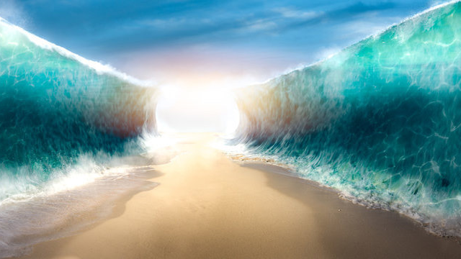
God is at work to have such a relationship with His people that He is described as dwelling among them.
God Is Not Done Yet
Sunday 11 a.m.
#exodus #Passoverlamb #law #tabernacle

Slide 2
²⁵ Then Joseph made the sons of Israel swear, saying, "God will surely take care of you, and you shall carry my bones up from here." ²⁶ So Joseph died at the age of one hundred and ten years; and he was embalmed and placed in a coffin in Egypt. (Gen. 50:25-26)

Slide 3
God said to Abram, "Know for certain that your descendants will be strangers in a land that is not theirs, where they will be enslaved and oppressed four hundred years. (Gen. 15:13)

Slide 4
Moses took the bones of Joseph with him, for he had made the sons of Israel solemnly swear, saying, "God will surely take care of you, and you shall carry my bones from here with you." (Exod. 13:19)

Slide 5
Now they buried the bones of Joseph, which the sons of Israel brought up from Egypt, at Shechem, in the piece of ground which Jacob had bought from the sons of Hamor the father of Shechem for one hundred pieces of money; (Jos. 24:32)

Slide 6
For I do not want you to be unaware, brethren, that our fathers were all under the cloud and all passed through the sea; ² and all were baptized into Moses in the cloud and in the sea; ³ and all ate the same spiritual food;

Slide 7
⁴ and all drank the same spiritual drink, for they were drinking from a spiritual rock which followed them; and the rock was Christ. ⁵ Nevertheless, with most of them God was not well-pleased; for they were laid low in the wilderness.

Slide 8
⁶ Now these things happened as examples for us, so that we would not crave evil things as they also craved. (1 Cor. 10:1-6)

Slide 9
1. Salvation is Certain, Safe, and Secure

Slide 10
Now these are the names of the sons of Israel who came to Egypt with Jacob; they came each one with his household ² Reuben, Simeon, Levi and Judah; ³ Issachar, Zebulun and Benjamin; ⁴ Dan and Naphtali, Gad and Asher.

Slide 11
⁵ All the persons who came from the loins of Jacob were seventy in number, but Joseph was already in Egypt.⁶ Joseph died, and all his brothers and all that generation. ⁷ But the sons of Israel were fruitful and increased greatly, and multiplied, and became exceedingly mighty, so that the land was filled with them. (Exod. 1:1-7)

Slide 12
2. God’s Blessings Can Lead To Persecution

Slide 13
⁶ Joseph died, and all his brothers and all that generation. ⁷ But the sons of Israel were fruitful and increased greatly, and multiplied, and became exceedingly mighty, so that the land was filled with them. ⁸ Now a new king arose over Egypt, who did not know Joseph.

Slide 14
⁹ He said to his people, "Behold, the people of the sons of Israel are more and mightier than we. ¹⁰ "Come, let us deal wisely with them, or else they will multiply and in the event of war, they will also join themselves to those who hate us, and fight against us and depart from the land."

Slide 15
¹¹ So they appointed taskmasters over them to afflict them with hard labor. And they built for Pharaoh storage cities, Pithom and Raamses. (Exod. 1:6-11)

Slide 16
¹² But the more they afflicted them, the more they multiplied and the more they spread out, so that they were in dread of the sons of Israel. ¹³ The Egyptians compelled the sons of Israel to labor rigorously;

Slide 17
¹⁴ and they made their lives bitter with hard labor in mortar and bricks and at all kinds of labor in the field, all their labors which they rigorously imposed on them. (Exod. 1:12-14)

Slide 18
¹⁵ Then the king of Egypt spoke to the Hebrew midwives, one of whom was named Shiphrah and the other was named Puah; ¹⁶ and he said, "When you are helping the Hebrew women to give birth and see them upon the birthstool, if it is a son, then you shall put him to death; but if it is a daughter, then she shall live." (Exod. 1:15-16)

Slide 19
3. When All Seems Lost,
There is Still God

Slide 20
¹⁷ But the midwives feared God, and did not do as the king of Egypt had commanded them, but let the boys live.... ²⁰ So God was good to the midwives, and the people multiplied, and became very mighty. ²¹Because the midwives feared God, He established households for them. (Exod. 1:17, 20-21)

Slide 21
I will lift up my eyes to the mountains; From where shall my help come? My help comes from the LORD, Who made heaven and earth. He will not allow your foot to slip; He who keeps you will not slumber. Behold, He who keeps you will neither slumber nor sleep. The LORD is your keeper; The LORD is your shade on your right hand. The LORD will protect you from all evil; He will keep your soul. From this time forth and forever. (Psa. 121)

